Slide 1
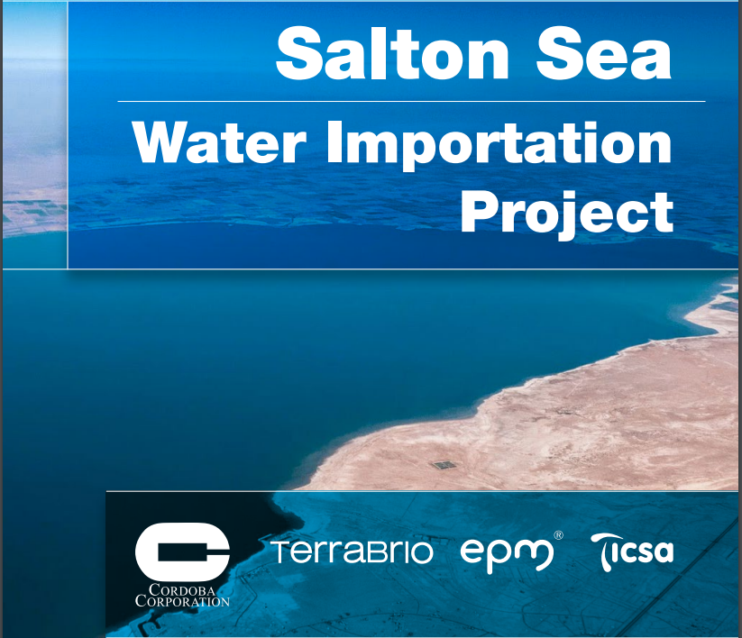

Slide 2
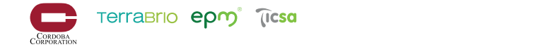
Salton Sea Water Importation Project Key Success Factors
Provide a long term, collaborative, & cost effective solution that will: Resolve serious HEALTH issues in the shortest time possible Create and recover the ECOSYSTEM for birds, fish and other animals Give LIFE to the Salton Sea Community: Recover and stabilize the water front Create ECONOMIC VALUE for the region INTEGRATES well with existing restoration projects and 10 year Plan Obtain all project PERMITTING and Right-of-Way easements STAKEHOLDER ENGAGEMENT: Inter-agency and bi-national project definition & approval (22+ agencies) – cooperative agreements/MOUs/Master SE Plan
Notes:
Lucy – with Introduction of the Team
Two key team members – Cordoba & Terrabrio
Cordoba has over 30 years experience in large civil infrastructure projects like this one and is currently working on some of the most iconic civil engineering projects in California – HSR, Owen’s Lake and gas and electric distribution upgrades .
Terrabrio is a water treatment and conveyance company with extensive experience throughout Mexico, Latin America and the US.
Our project is focused on ensuring a long term, cost effective and collaborative solution to rsulting from the current situation at the Salton Sea –
Address the health issues quickly
Improve the natural habitat
Revitalize the salton sea community providing real economic value to all communities surrounding the sea
Worked diligently to ensure our project could be phased in with ongoing work / restoration projects at the Salton Sea – so one - results could be obtained quickly and two – not one dollar that has been invested to date would be wasted
Hollistic – comprehensive solution – there is no silver bullet.
Submerge the playa to prevent the release of dust
Create a low salinity clean water estuary to provide habitat for migrating birds and fish (Perimeter Lake Concept)
Provide a long-term solution to confine of high saline water within the inner lake
Develop a constant level water feature that would stimulate investments around the perimeter of the Salton Sea and create economic stability
Positive revenue, sustainable and predictable contribution to the local economy
Local job creation
Develop a mutually beneficial bi-national project for USA and México
Earliest solution to mitigate dust – Most feasible water import solution
Comprehensive financial solution based on a phased approach

Slide 3
Stakeholder Engagement Process
One key success factor for this project – an open dialogue and well developed and collaborative stakeholder management plan
A collaborative approach with key stakeholders – such as Salton Sea Authority and the California National Resource Agency (CNRA) – to establish key project parameters - such as lake levels and perimeter, water salinity etc.
Integrate Estuary/Perimeter Lake solution into the 10 Year Plan.
A multi task effort with involved stakeholders in the USA and Mexico, needs to be organized and promoted
Cross Border Governmental Coordination and Permitting - key bi-national working agreements and special treaty development

Slide 4
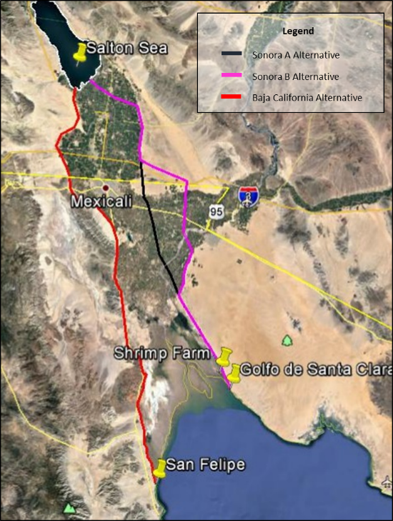
Salton Sea Water Importation Project
Sea of Cortez Alternatives
Key Factors in determining best alternative
1) Environmental and Water Permits
  Protected Areas
  Protected Species
  Water balance
2) Social conditions
  Project Impact and Benefits
3) Right of Way
  Ejido, Private, Communities
4) Utilization of existing infrastructure
5) Elevation and Terrain Conditions
  Cost of Energy
  Cost of Conveyance Line
6) Conveyance Length
7) Investment

Slide 5
Salton Sea Water Importation Project Feasibility
Sea of Cortez – Water Sources and Feasibility
Viable Sites (Two Alternatives):
Sonora: Existing Shrimp farm that is no longer in operation or the Golfo de Santa Clara.
Baja California Norte: Mexicali Valley or San Felipe
Options:
Water intake directly from the Sea of Cortez
Network of Wells
Combination of both
Develop a feasibility analysis that considers environmental, social, permits, technical viability and ROW contracts.
Identify Key Constraints, including environmental, regulatory, governmental approval factors etc.
Analysis and definition of the 2 most viable alternatives.
Notes:
Need to explain why

Slide 6
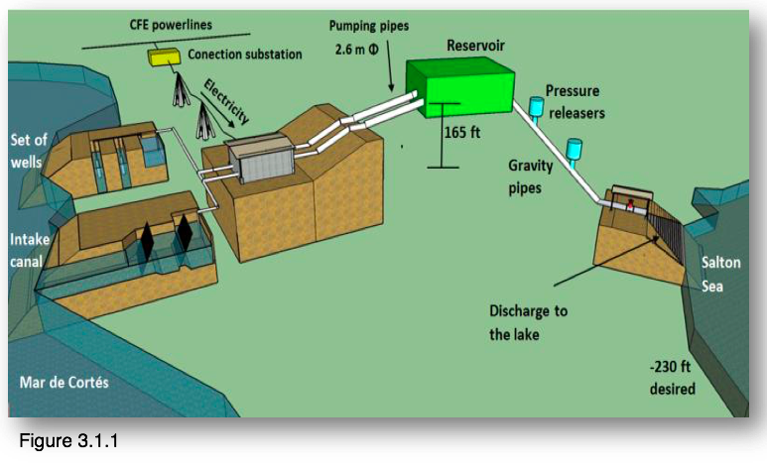
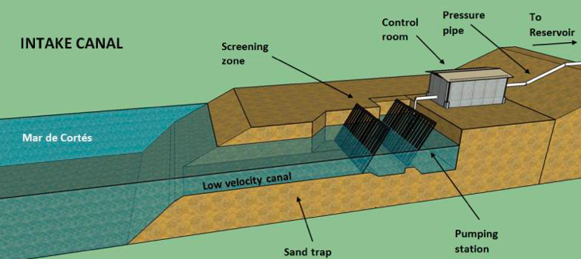
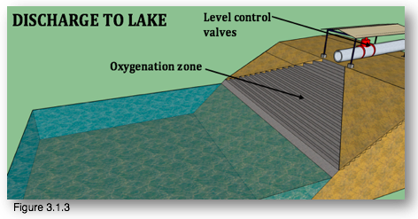
Salton Sea Water Importation Project
Conceptual Drawings
Project Overview
Extraction Intake
Perimeter Lake Distribution

Slide 7
Perimeter Lake Approach
Desalination-Salinity Management
Future opportunity to be analyzed
  A Desalination project may be utilized to balance salinity. The electrical requirements will be met by development of a turbine on the downside slope of the importation line.
  Obtaining the required permits to bring Sea Water from the Sea of Cortez to Salton Sea will be critical.
As a opportunity, a desalination project that can provide fresh (partially desalinated) water and be an important economic source for the project sustainability
Notes:
Need to explain why

Slide 8
Project Goals & Objectives
Compliments current Salton Sea restoration projects and the approved 10 year Plan Provides a long term solution to the critical challenges currently presented by Salton Sea Focuses on collaboration with stakeholders to define best project alternative based on technical viability, permitting requirements, schedule, economic impact and community benefits Considers several viable alternatives in the Sea of Cortez, giving higher level of success to obtain required permits and ROW acquisition Provides flexibility to incorporate valuable adjustments or alternatives, such as use of existing infrastructure or other state water projects – like Delta Fix Generates real economic value and job creation to the local community
Notes:
Not one dollar of the investment made to date for restoration and planning would be negated or wasted but instead would be completely integrated and leveraged
Long term solution to worsening health issues, impacts to natural habitat, and economic stability OF ALL communities surrounding the sea
Perimeter Lake – allows for economic stimulus & return of tourism – aligns with other recommended projects by Riverside county – but this extends those benefits to all communities surrounding the lake
Flexibility – future geothermal investments in the area could be leveraged to generate additional revenue and help offset O&M costs; leveraging existing infrastructure or resources – like White water River – Projects like the delta fix, prop 1

Slide 9
THANK YOU!!
If you have any questions or comments, please contact: Richard Coles Senior Vice President of Water Infastrture Cordoba Corporation Rcoles@cordobacorp.com (949) 233-7681

