Slide 1
Water Import, Salt Extraction Revenue (WISER)
A Plan to Restore the Salton Sea and
to Pay for the Restoration.

Slide 2
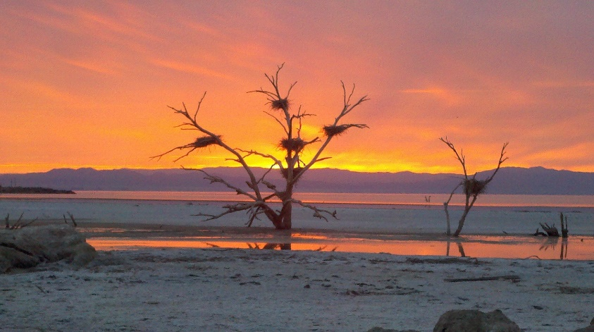
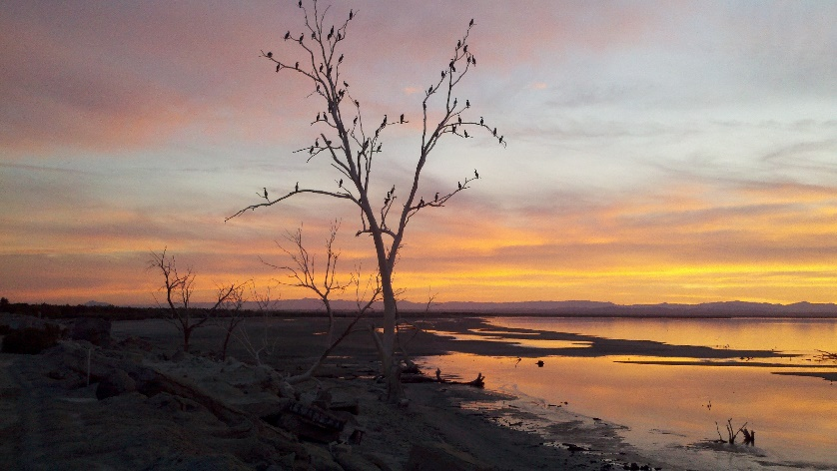
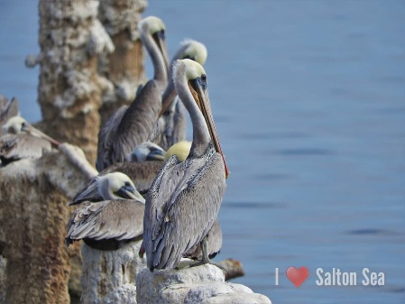
Water Supports Life
Where clean water is available, life thrives. The Salton Sea has long been a critical habitat for birds on the Pacific Flyway. In prehistory this desert basin was repeatedly flooded with Colorado River Water and full of fish and birds.
The population of fish and birds are now in rapid decline due to quickly rising salinity. This is caused by the fact the Salton Sea is a terminal lake more than 200 feet below sea level. Water and salt flow in, water alone evaporates, leaving the salt behind.
WISER proposes 500,000 AFY of ocean water import through Laguna Salada and will distill and return salt free clean water to the Salton Sea ecosystem. Our thermal distillation process is not free, but the value of the pure salt extracted pays for it completely. Impure salts will be used to produce power.
Photos: Tom Sephton and JJ Phillips Photography

Slide 3
WISER Project Distilled Water Production
Import 500,000 acre feet annually through a Laguna Salada canal.
Pay Public Agencies or Private Companies to build and run the canal
Pay them $110 per acre foot to deliver water, that pays for the canal.
Distill 250,000 acre feet per year of Salton Sea water, give to habitat.
Distilling water drawn directly from the Salton Sea removes more salt.
© Sephton Water Technology, Inc 2020

Slide 5
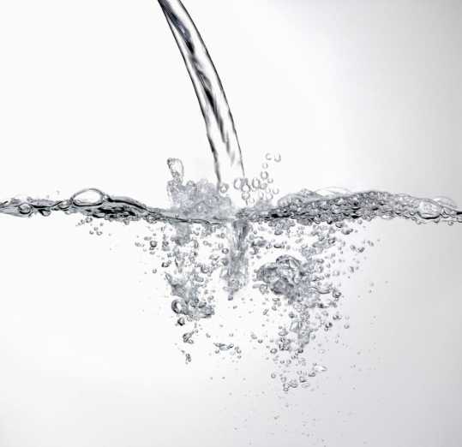
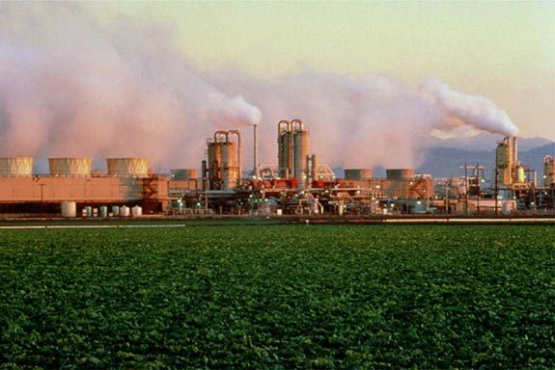
Water Import, Salt Extraction Revenue (WISER) Sources of Revenue
Salt Water Power
The cash business is purified Sea Salt and Power. The ancillary benefit and potential added revenue source is Pure Water. The energy resource is renewable geothermal and solar thermal energy.

Slide 6
Why Sell Salt?
Our process produces pure water distilled from the Salton Sea. One would think the water would be the valuable product. But, at $20 per acre foot, raw Colorado River water is very cheap locally and water is very expensive to move long distances. Since desalinated water cannot compete in the local market, can the waste product of most desalination processes (salt) provide an superior source of revenue?
Refined sodium chloride is worth over 100 times more than desalinated water ton for ton. The Salton Sea is hyper-saline already at 65 g/liter TDS. Roughly four million metric tons of salt come into the Salton Sea annually from rivers and agricultural drains. The supply is abundant, but it needs purification. Because the value of salt is 100 times higher than water it becomes practical to ship it out to domestic markets by truck or rail. Cost effective purification of Salton Sea salt can be the revenue core of a profitable business where pure water is a bonus to give back to the environment to help preserve a vital fish and bird ecosystem.
Data Source: USGS and SDCWA

Slide 7
US Salt Market Consumption & Production The US imports well over 10 million tons of salt annually across all grades
© Sephton Water Technology, Inc 2020

Slide 8
US Salt Market Pricing Refined and Solar Salt prices are rising faster than inflation
© Sephton Water Technology, Inc 2020

Slide 9
WISER Commercial Salt Production
Solar Salt and Refined Salt are the grades that are profitable here
Balance refined and solar salt production with market demand
© Sephton Water Technology, Inc 2020

Slide 10
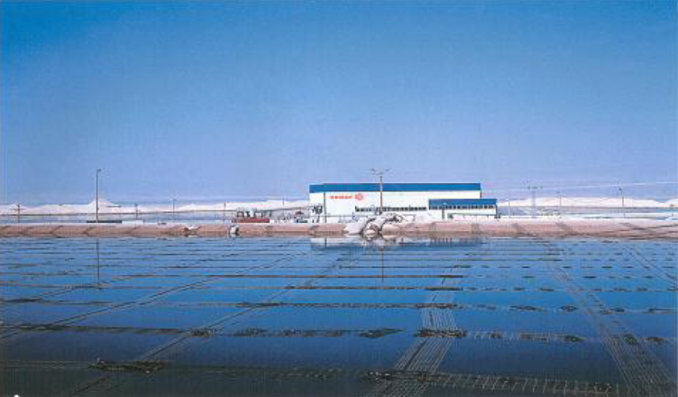
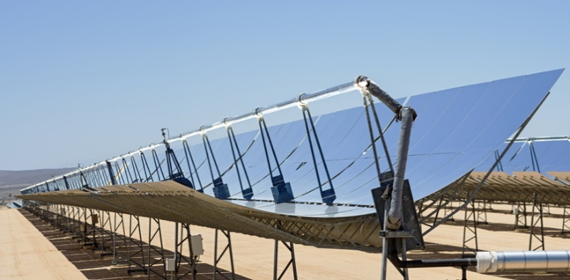
Renewable Power Runs the Process
The Imperial Valley, CA is one of the world’s best resources for geothermal energy. The geothermal field on the south shore of the Salton Sea is the hottest, most productive geothermal resource in the area. We locate there for the heat to distill Salton Sea water.
The waste product of most desalination processes is high salinity brine. A waste product for a standard desalination process is a renewable energy resource for our process. After separating marketable salts, we will concentrate the brine to produce solar heat in a salinity gradient solar pond.
Our process can also use concentrating solar power as a primary heat source. Parabolic trough arrays can produce more than enough heat to supply the distillation process, and power for pumps.

Slide 11
WISER Project Power Sales
© Sephton Water Technology, Inc 2020

Slide 12
WISER Project Financial Estimates
Project will be profitable four years after commencing operation
Construction financing is based on 30 year loans paid at 12% interest
© Sephton Water Technology, Inc 2020

Slide 13
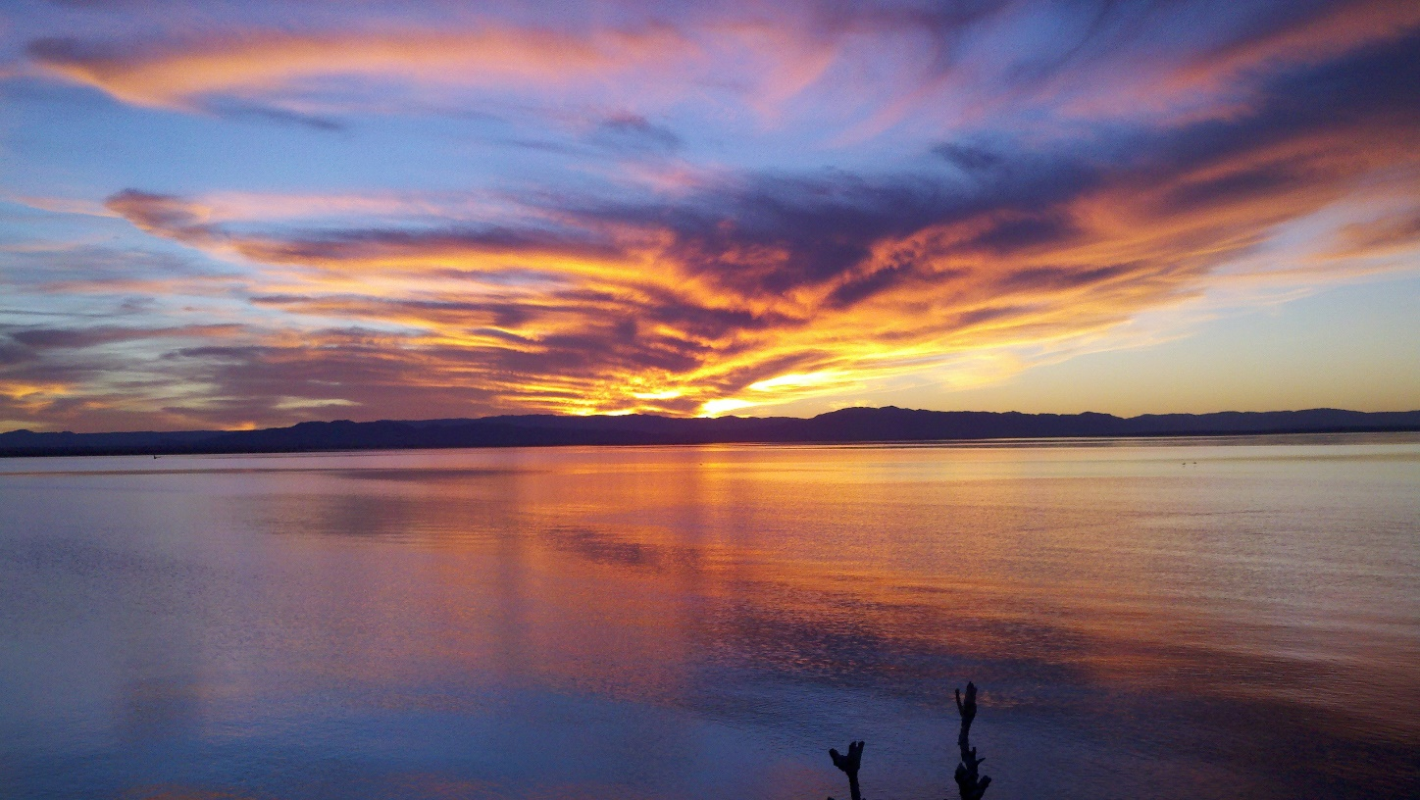
Remove Salinity to Benefit the Salton Sea Annual salt removal from the Salton Sea with 12 desalination plants 20 MGD each.
12 large commercial 60 effect 20 MGD VTE-MED plant with salt production and salinity gradient solar ponds can in time remove all salt coming into the Salton Sea each year from agricultural drainage and ocean water import. That would put salinity in balance.
© Sephton Water Technology, Inc 2020

Slide 14
WISER Project Restores Salton Sea Elevation
© Sephton Water Technology, Inc 2020

Slide 15
WISER Project Eliminates Playa Dust
© Sephton Water Technology, Inc 2020

Slide 16
WISER Project Restores Salton Sea Salinity
© Sephton Water Technology, Inc 2020

Slide 17
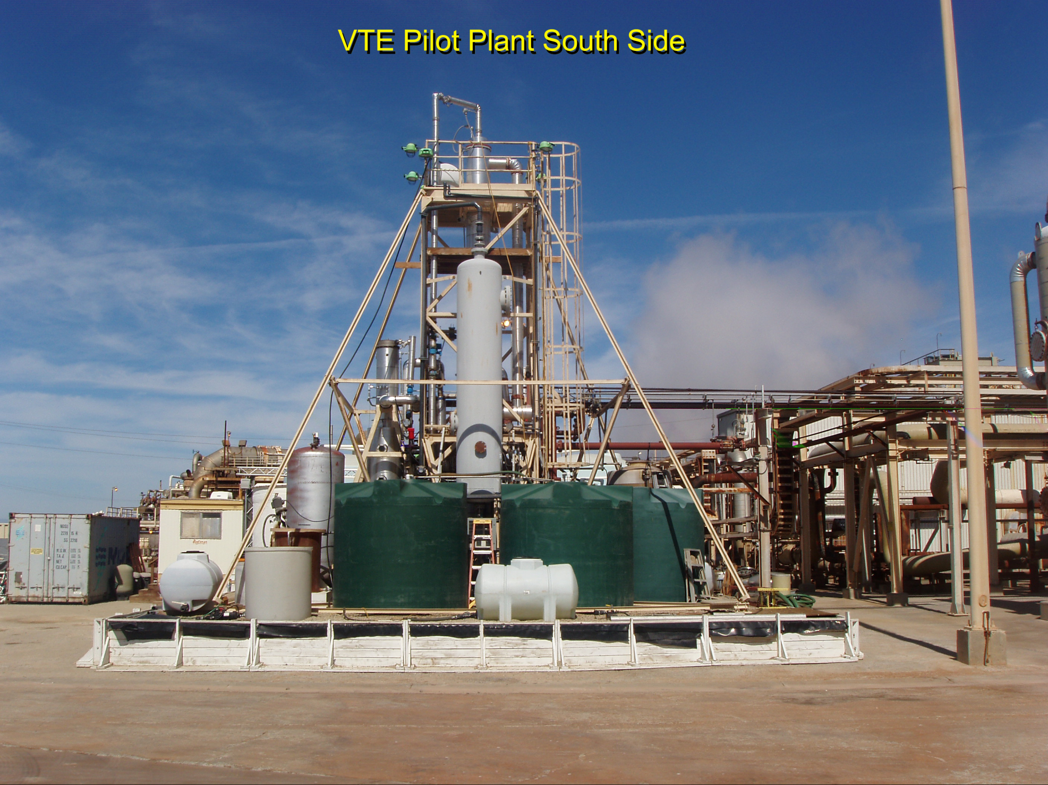
Product of 14 years of work at the Salton Sea
© Sephton Water Technolgy, Inc. 2010

Slide 18
Salton Seawater Divalent Ion Separation Process, Developed in 2009 - 2011
© Sephton Water Technology, Inc 2015

Slide 19
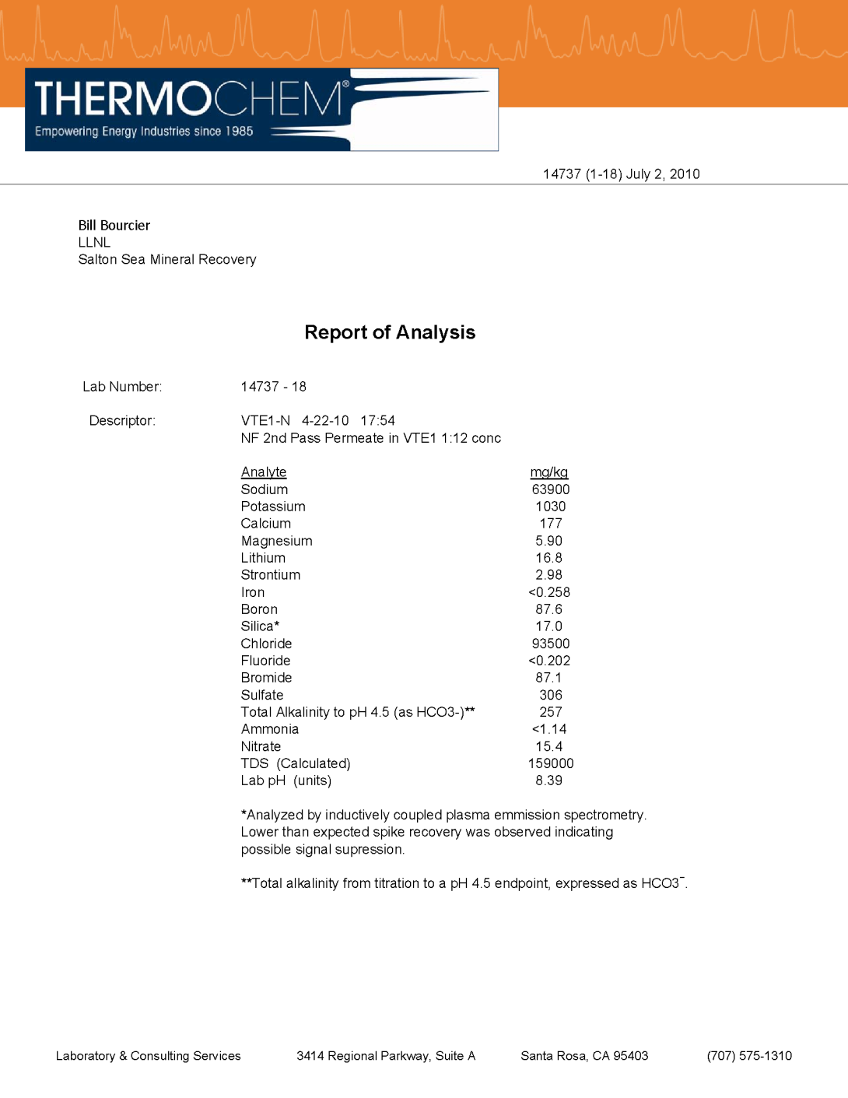
2010 Salt Separation Results Analysis of treated Salton Sea water showing 99% pure sodium chloride brine
Sodium 63,900 mg/liter
Chloride 93,500 mg/liter
TDS 159,000 mg/liter
(Na+Cl)/TDS = 0.9899
99% purity NaCl is commercial grade solar salt and can be refined to 99.9% pure food grade
Source: VTE Project data 2010

Slide 20
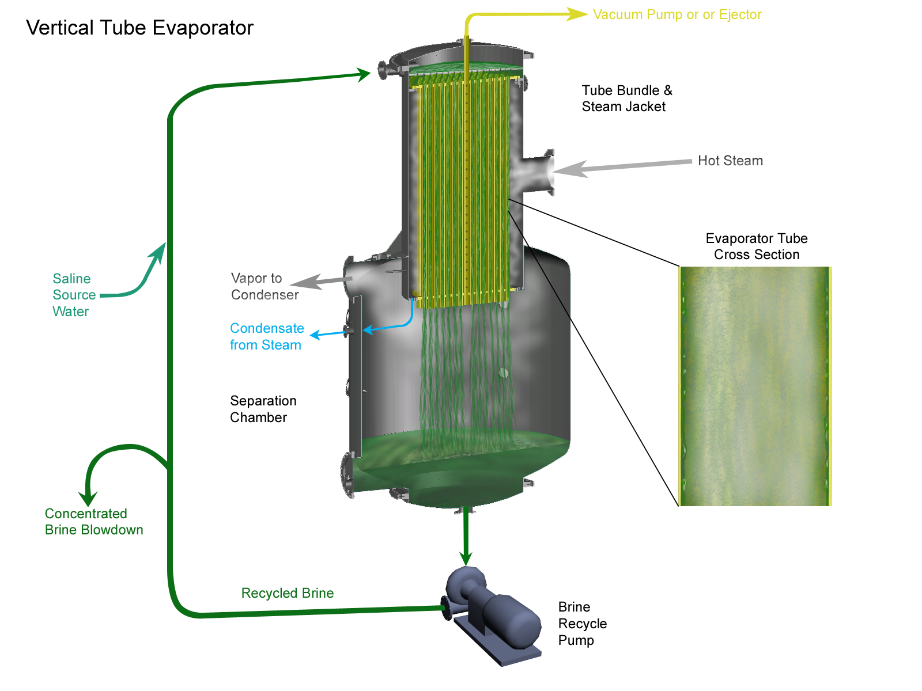
Single effect in down-flow mode
Brine flows down inside tube wall in an annular layer with evaporating vapor in the tube center.
© Sephton Water Technology, Inc. 2013

Slide 21
Multi Effect VTE Plant Concept Schematic
Reverse Feed Operation with ‘N’ Effects and Non-Commercial Atmospheric Flash Geothermal Steam as the Primary Heat Source
Vacuum
Pumps
Non-Condensable
Gasses to Vacuum
Effect N
Effect 3
Effect 2
Effect 1
Saline Water
Feed Source
Such as
Seawater
Water Vapor
212 °F - 5XN°F
Water Vapor
202°F
Water Vapor
207°F
Geothermal
Steam
212°F
Vapor
Out
Evaporator
Effect N
Evaporator
Effect 3
Evaporator
Effect 2
Evaporator
Effect 1
Condenser
Distilled Water
80% to 90% of
Feed Source
Geothermal
Condensate
Return
Ambient temperature saline water is fed to Effect N where it is heated, evaporated, and concentrated then fed to Effect N-1 and so on, rising in temperature and concentration with each Effect. Geothermal steam at atmospheric pressure (212°F) provides the thermal energy source for Effect 1. Water vapor evaporated from the saline water concentrate in Effect 1 provides the thermal energy source for Effect 2. Likewise, water vapor evaporated from saline water in Effect 2 becomes the energy source for Effect 3 and so on for N effects. The number of effects possible is limited by the temperature difference between the geothermal steam and the cooling water.
Cooling Water
Source
Saline Water
Concentrate
10% to 20% of
Feed Source
Cooling Water
Return
© Sephton Water Technology, Inc. 2010

Slide 22
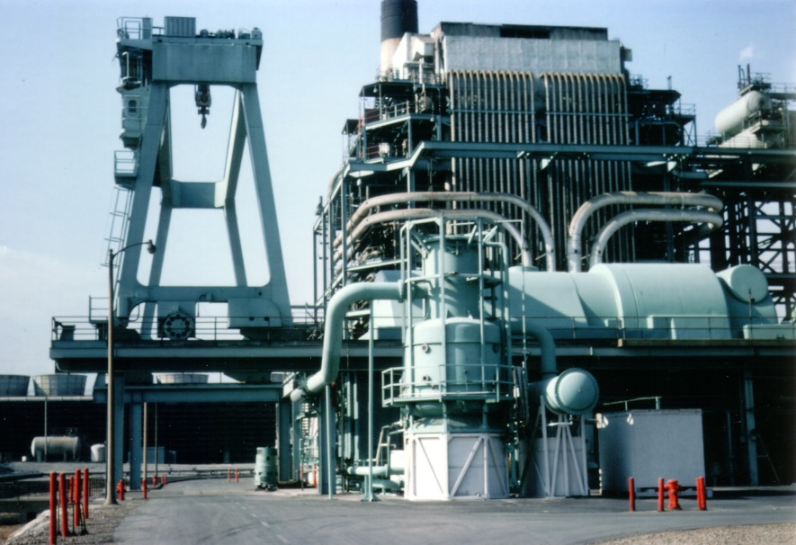
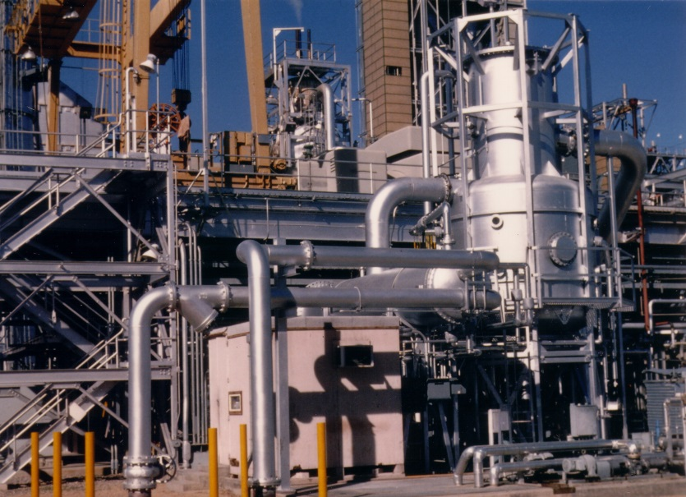
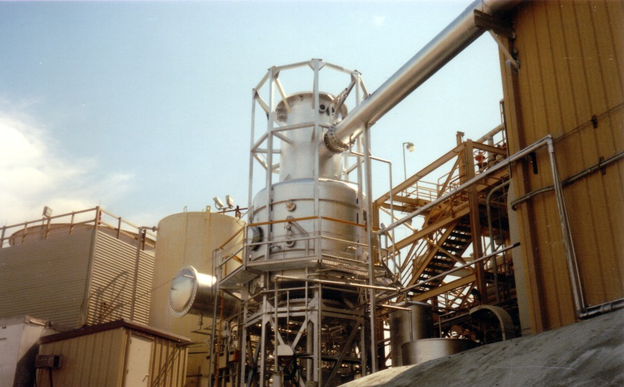
Sephton Water Technology, Inc.
Etiwanda Generating Plant SCE, Mohave Desert 1982
Coolwater Coalgas, Texaco, Mohave Desert 1986
Sephton Water Technology, Inc.
tomsephton@sephtonwatertech.com
Cell: 760-623-2583
Modesto Energy Plant, Modesto, CA 1989
© Sephton Water Technolgy, Inc. 2014

